Slide 1
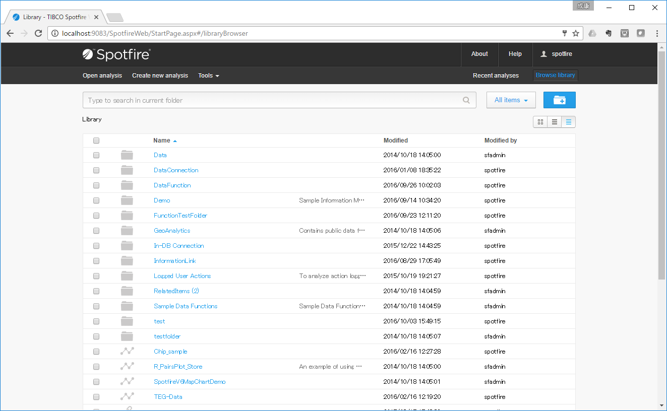
Are there any settings to expand Description width?

