Slide 1
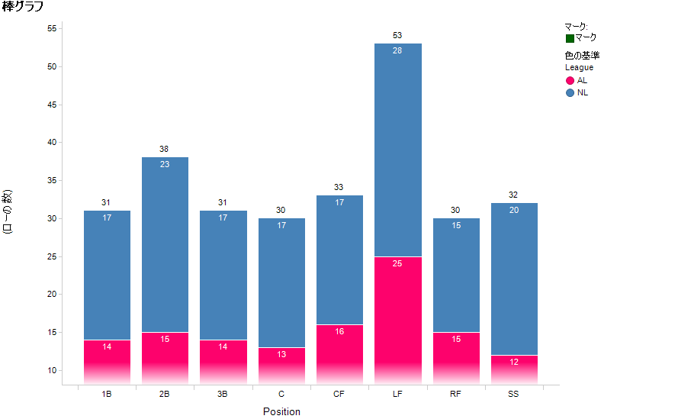
ページ
Ver6.5 case.
Labels for each section is aligned top.

