Slide 1
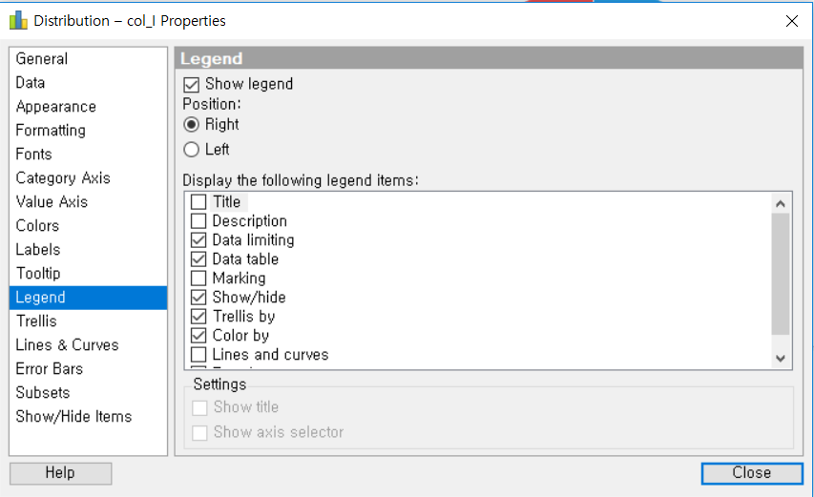
Lables
It is better to insert ‘Lables’ check box in ‘Displaying the following legend items’ list.

