Slide 1
Data Analysis:
Spotfire in engineering format presentation
Luc v/d Linden (PEng CBU)
Tuesday, 12 Januari 2018

Slide 2
Why in engineerings format?
Engineers work normal with data values in engineering's format.
SF is not delivering this by default
As work around you can install it local, on your ownacoount.

Slide 3
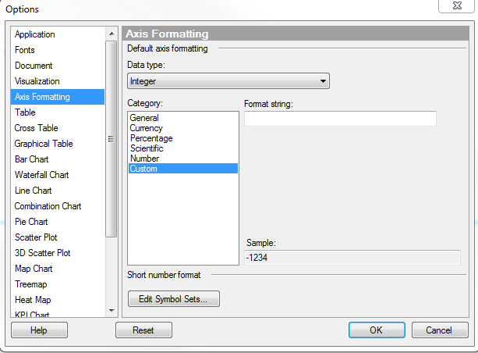
How?
Go to tools/options
Select Axis Formatting
Choose [Edit Symbol Sets]

Slide 4
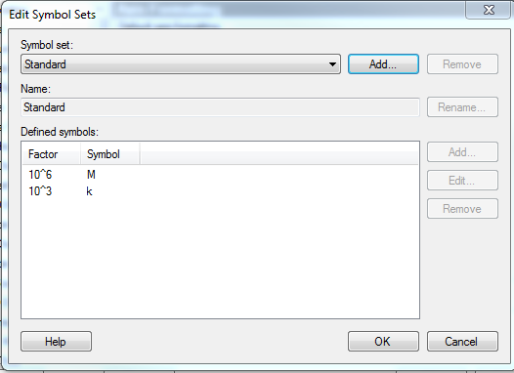
Make the table
Add new table “Dialog”

Slide 5
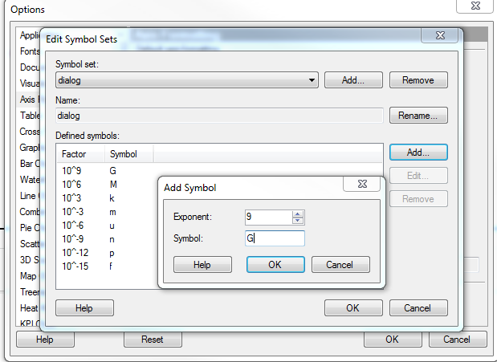
Edit the table
Fill the table
Repeat this for each value

Slide 6
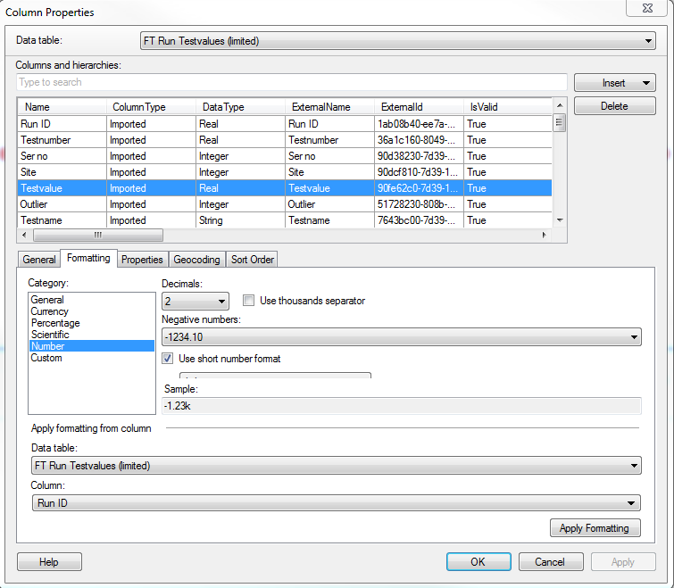
How to use
Goto column properties
Select column
Formatting in Number
Use short number format select Dialog

