Slide 1
Format numbers in Engineering's format
A special exponent way of presenting
A metric prefix, following steps of 1000 (e3)
Benefit: many electronic calculations are like 1/x=y.
  So 1V/uA → becomes Mohms
Multiples | Prefix name |  | kilo | mega | giga | tera | peta | exa | zetta | yotta
 | Prefix symbol |  | k | M | G | T | P | E | Z | Y
 | Factor | 10⁰ | 10³ | 10⁶ | 10⁹ | 10¹² | 10¹⁵ | 10¹⁸ | 10²¹ | 10²⁴
Fractions | Prefix name |  | milli | micro | nano | pico | femto | atto | zepto | yocto
 | Prefix symbol |  | m | μ | n | p | f | a | z | y
 | Factor | 10⁰ | 10⁻³ | 10⁻⁶ | 10⁻⁹ | 10⁻¹² | 10⁻¹⁵ | 10⁻¹⁸ | 10⁻²¹ | 10⁻²⁴

Slide 2
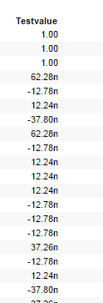
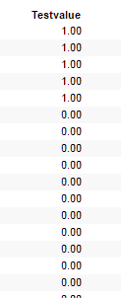
Presentation
                Default presentation: Wanted presentation:

