Slide 1
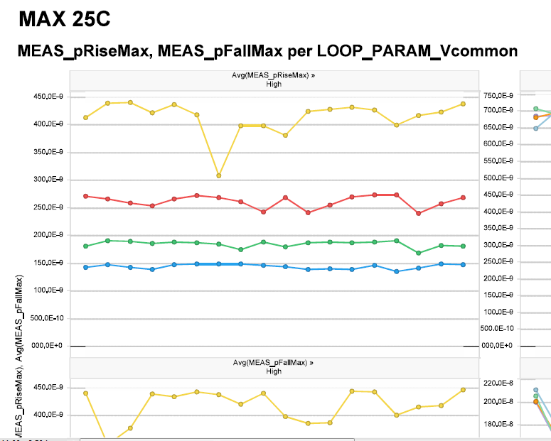
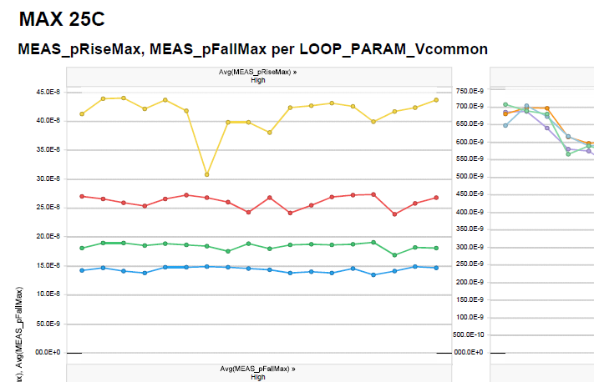
After user’s adjusting scientific formatting of Y axis
Juan:
I've had the file correctly formatted and saved, but every time I add more data or expand my Trellis, ALL the Y-Axis get changed, and I have to painfully correct every single graph!
Imagine if I had a trellis with 40-50 graphs?
(see comparison between 'before' and 'after' for the same graphs).
Please also see Excel sample attached. In Excel, I simply use the Engineering notation: ##0.00E+00 and the Axis is correctly formatted, regardless if I have one or more significant digits.
(in sample, from 2e-3 to 18e-3); also note that the entire axis is E-03.
But Exensio mixes them, showing for instance E-10 to E-9 on the same graph. I need them ALL to be E-9 (or E-6, or E-3, etc, in Engineering notation).
So, the 'before' graphs should read 50E-9 (instead of 500E-10), and keep them all with E-9.

Slide 2
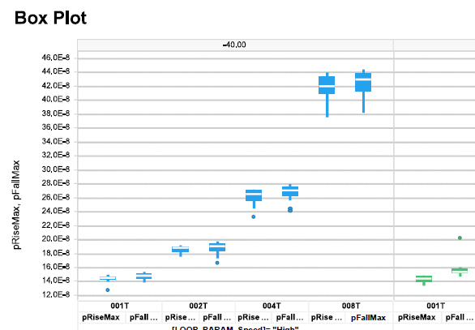
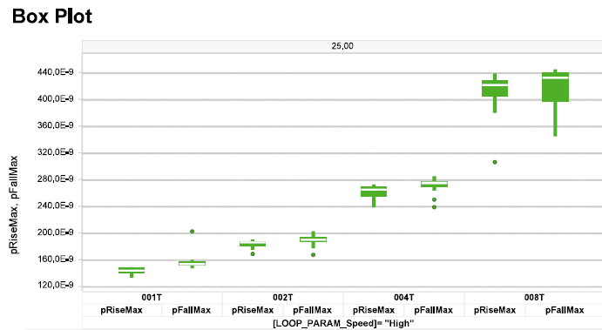
After user’s adjusting

Slide 3
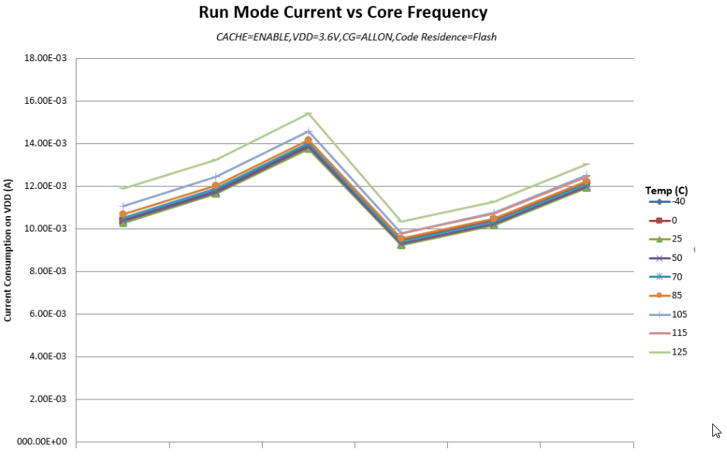
Excel’s chart

