Slide 1
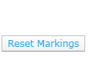
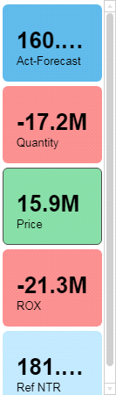
NTR index in euro
Index
Reset selections
Price-effect
NTR index in euro
NTR Waterfall
0.0
-1.0M
01
02
03
04
05
06
07
08
09
10
11
12
2018
Quantity-effect
4.0M
459.3k
-4.0M
-455.4k
-263.6k
-3.0M
-2.5M
-3.6M
-2.1M
-1.7M
-470.7k
Rox-effect
Index
110.0
103.8
106.7
105.0
100.5
102.5
102.8
101.1
0.0
100.0
95.0
-1.0M
90.0
85.0
80.0
01
02
03
04
05
06
07
08
09
10
11
12
01
02
03
04
05
06
07
08
09
10
11
12
2018
2018

