Slide 1
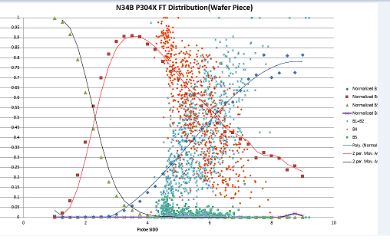
Here’s a chart user used other tools to draw, and want to make it in EY.

Slide 2
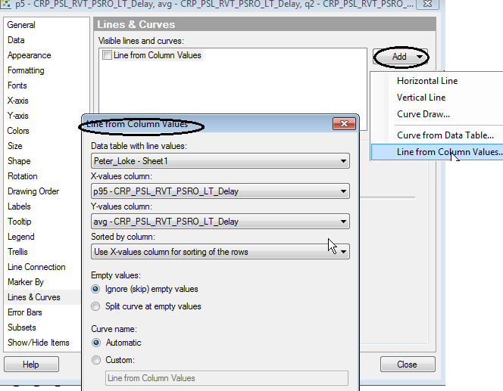
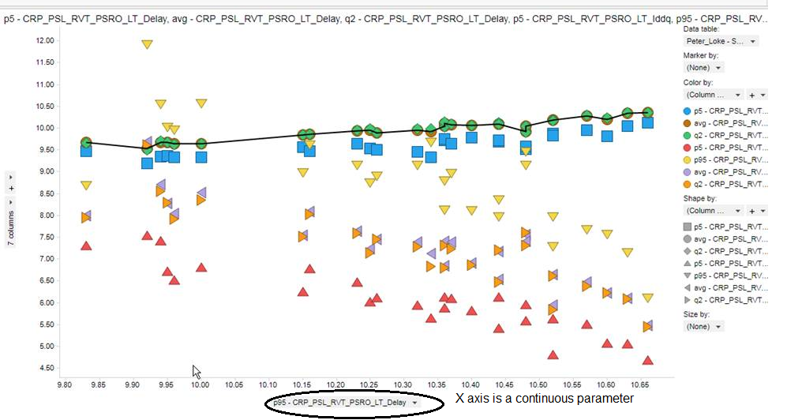
Import user’s .xls file, and user likes to have a line in scatter plot which has multiple parameters in Y axis(also color by)
It’s fine to use “line from column value” when X axis column data type is real.

Slide 3
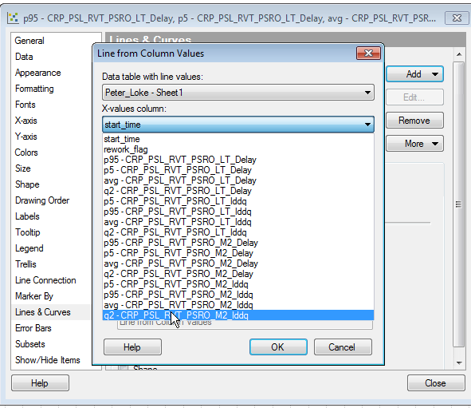
But, user likes lot as X axis. But, lot is not populated in list box of “line from column values” window.
How to have line in scatter plot for specific statistics or continuous parameter based on lot(X axis)?

