Slide 1
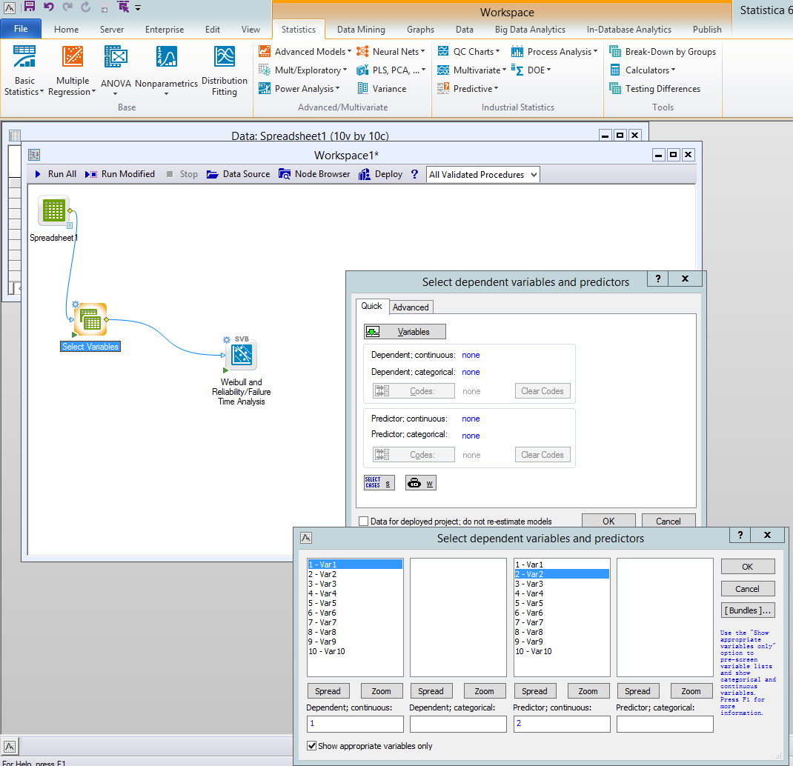
While selecting Variable in workspace node, we cannot select 3 variables similar like survival life data(Shown in Top).
But in the spreadsheet we can select variables as like survival life data.(Shown in Next Slide)

Slide 2
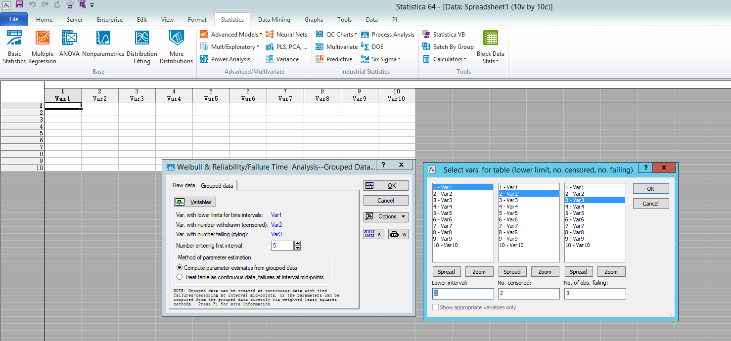
Similar variable selections like Group Data need in Select variable node in Workspace.

