Slide 1
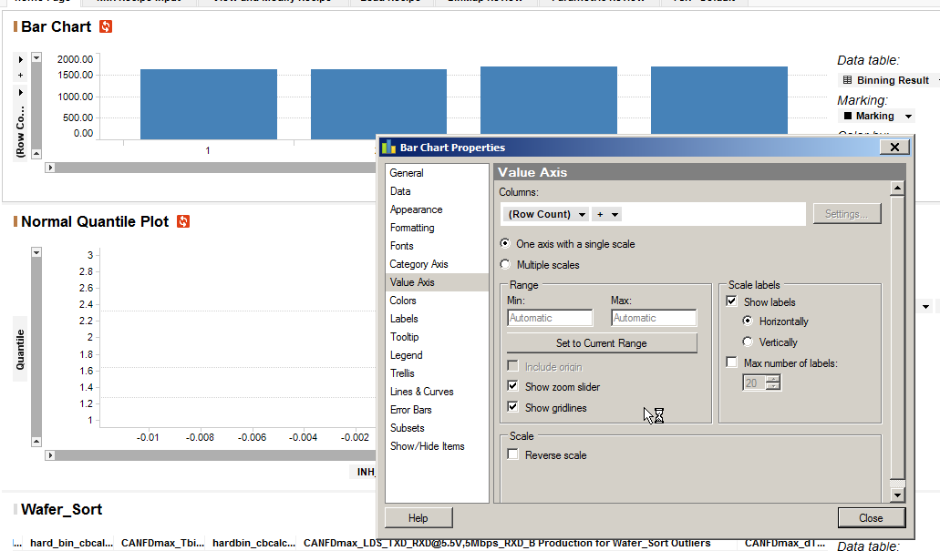
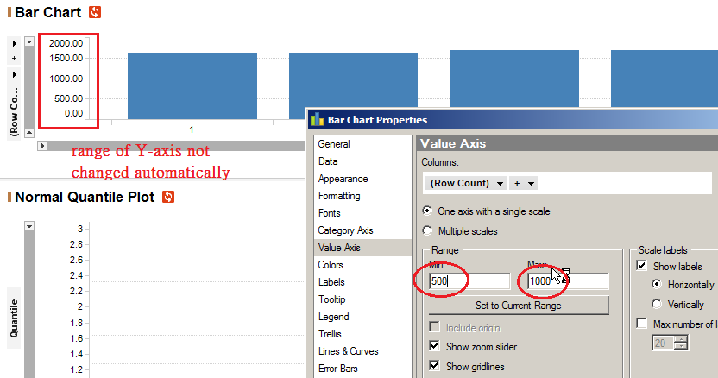
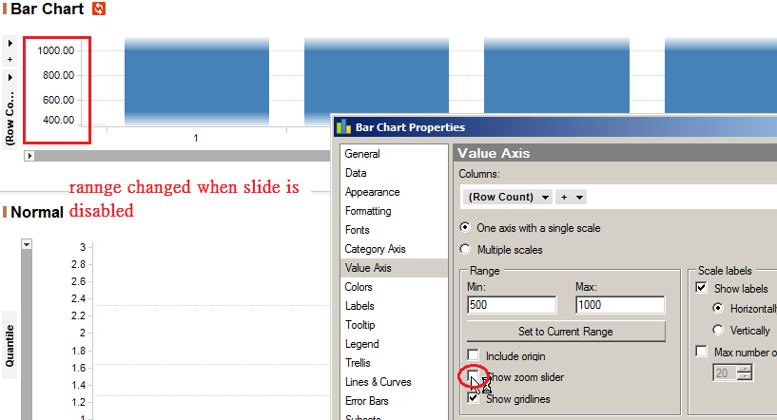
Y-axis range not changes automatically when range is set.
Only works when slider is disabled.

Slide 2
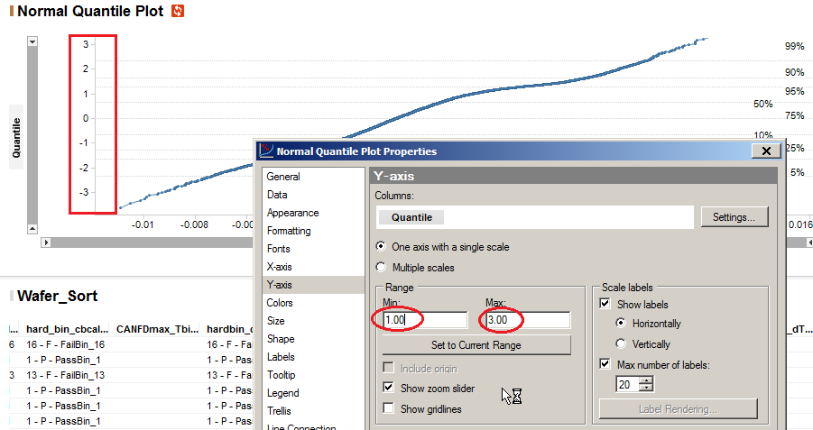
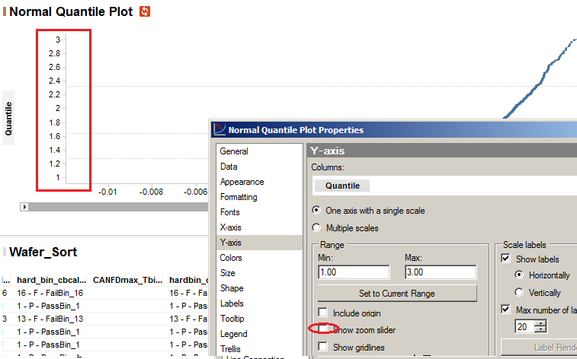
The same with Y-axis of NQP.
Range changes when only slide is disabled.

Slide 3


The same with X-axis of NQP

