Slide 1
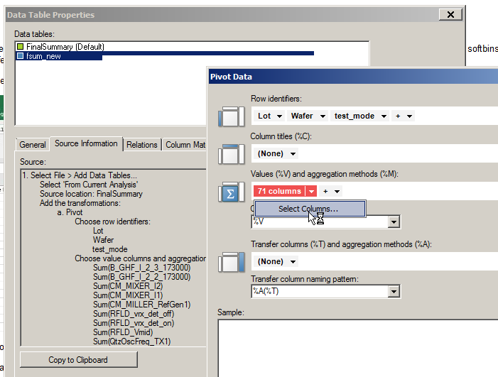
Table witt pivot data need to be refresh when template works with different products.

Slide 2
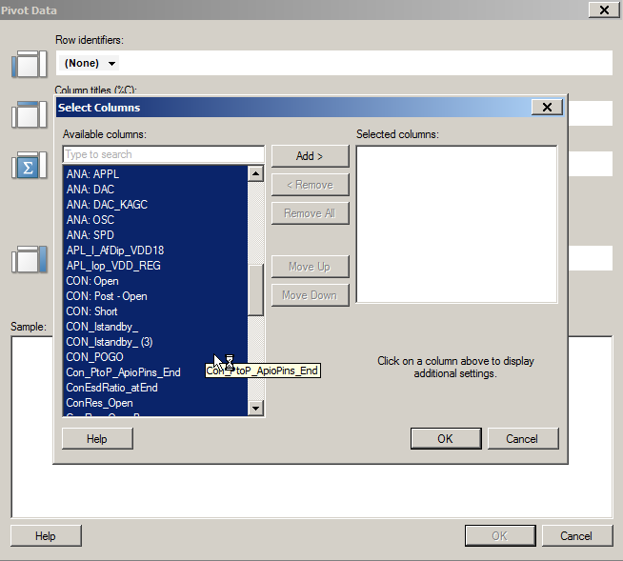
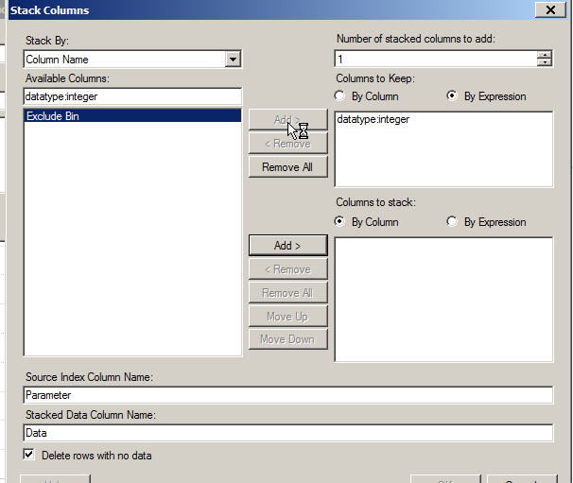
“by expression” option is not available in Pivot select column window.
But, in stack window, it’s available(see below, “datatype:integer” is used)

