Slide 1
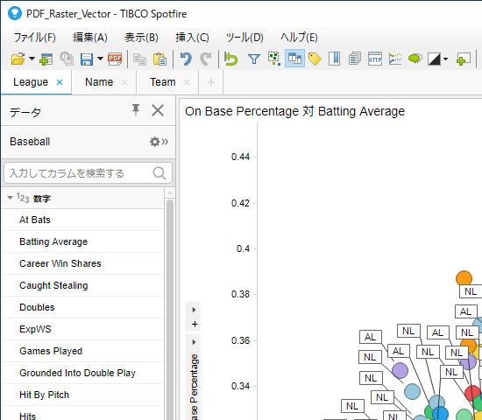
I made a simple DXP with 3 pages, and saved it into library with page “League” is active.
There’re 2 bookmarks that select page “Name” and “Team”.

Slide 2
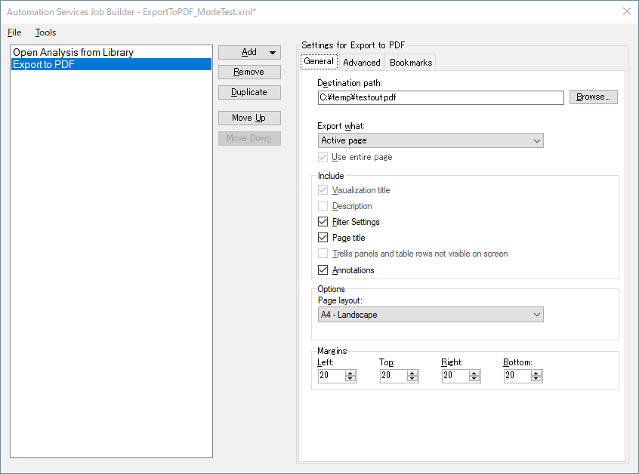
AS Job to Export to PDF.
“Active page” to export.

Slide 3
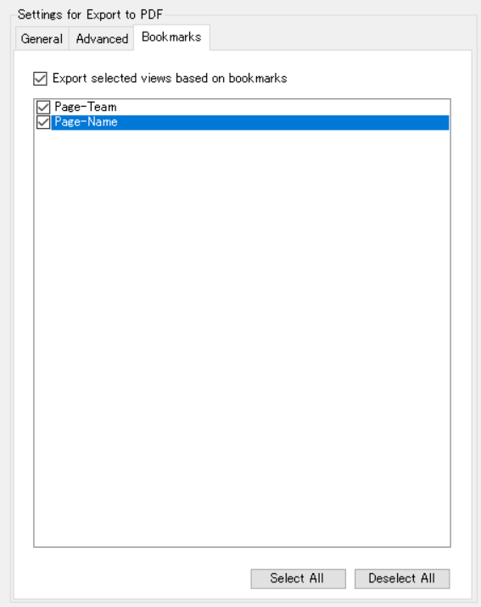
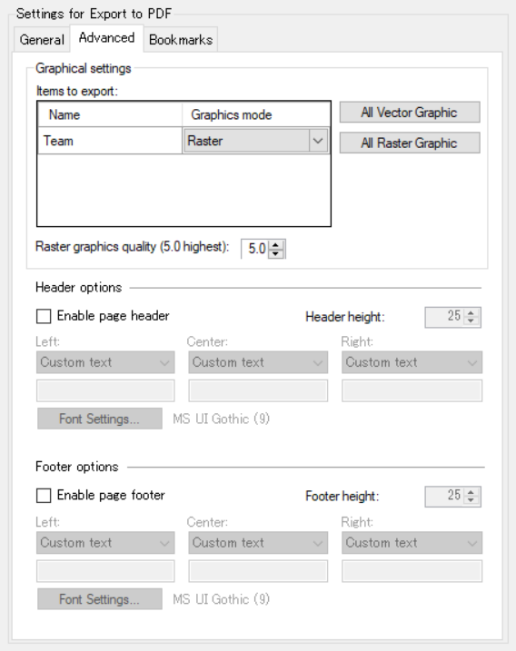
Select two bookmarks to export two pages.
But in “Items to export”, only “League” page, that are activated in loaded DXP, is listed to set Graphical mode.
This means pages in bookmarks are not checked. The same occurs if you select “Active visualization” in General tab, that only active vis in loaded DXP is listed.

