Slide 1
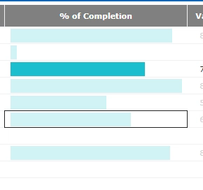
Flickering in Graphical Table(Bullet graph) on marking
Play the video attached to view the issue

