Slide 1
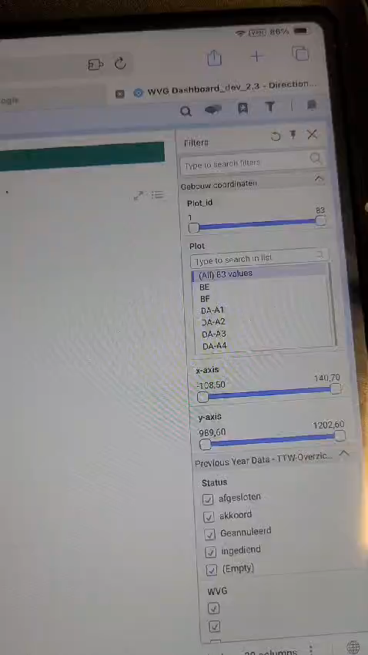
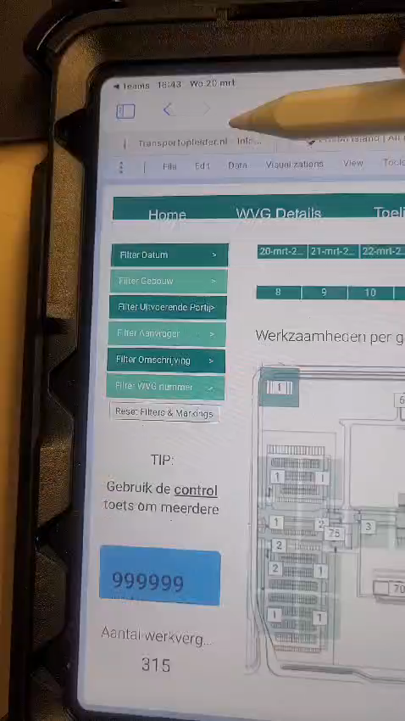

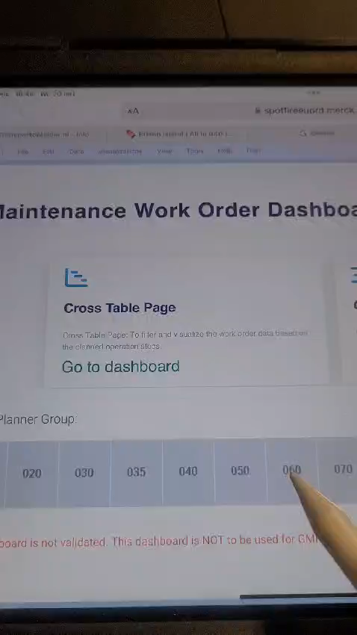
As observed by using Spotfire Dashboards on an iPad using the iPencil, we found a few limitations.
These limitation are outlined below:
1. The list box filters do not respond while using the iPencil. | 2. The list box filters do not respond even when added in the Text Area. | 3. KPI Chart visualization does not respond to the iPencil. | 4. Tree Maps visualization does not respond to the iPencil.

